Slide 1
It’s a Great Day to Save Lives (with a Mental Health Court)
Hon. Brent Carr, Kristi Taylor & Molly Davis
June 27, 2023
Notes:
Good morning and thank you for being here. Yesterday was electric. Absolutely affirming that I am in the right place and using my skills for a calling.
I started my career in a big law firm doing commercial real estate which is challenging and rewarding in a different way, but for me, nothing compares to using my education and strong work ethic toward creating better systems, better laws for people who really need our state’s best and brightest to help solve these complex problems.
I don’t know if anyone else noticed this, but we had thousands of people trying to eat lunch—it’s always going to be a challenge. What struck me is that everyone attending the conference was so patient and kind. I laughed with some of my line-mates that we knew what a crisis was and this wasn’t’ it.
It was awe inspiring—more confirmation that you are all my people.
So=It’s a great day to save lives! Let’s get started.

Slide 2
Content Warning: Suicide, Sexual Abuse, Substance Use

Slide 3
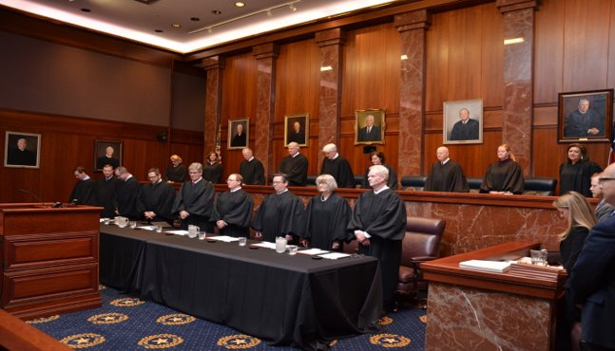
Notes:
First, I want to talk a minute about the Texas Judicial Commission on Mental Health.
JCMH Commissioners provide a deep well of collaboration through their diverse backgrounds and experiences. Commissioners meet at least three times a year, providing information to promote best practices and improve the function of the judiciary for those with mental health, substance use, or IDD needs.
The Collaborative Council keeps the JCMH updated on emerging issues in the field. JCMH staff holds quarterly calls where the collaborative council members share their organization’s conferences, projects, and best practices around the state.
Thought these two bodies, JCMH has member Judges from every level of the judiciary, MH experts, legislators, law enforcement, service providers, prosecutors, defense attorneys, doctors.

Slide 4
The Need for a Commission on Mental Health
Overcrowded dockets
A lack of communication, coordination and collaboration among courts, state and local mental health providers, attorneys, and mental health advocates
A need for specialized, multidisciplinary legal training
A need for technology to manage dockets and caseloads
A need for the children and adults involved in the justice system to have a voice in the decisions that affect their lives
A lack of community resources to provide adequate mental health services to children, youth, and families
Notes:
Before the commission was created, Chief Justice Nathan Hecht and Presiding Judge Sharon Keller were a part of the national conversation about mental health, including the work of the Conference of Chief Justices and Conference of State Court Administrators.
MH Committee recommended establishment of a permanent judicial commission on mental health, similar to the Children’s Commission, the Texas Access to Justice Commission, and the Texas Indigent Defense Commission.
We have 254 counties, 70% of them are rural
Silo example CPS and JJ

Slide 5
A historic joint hearing
January 11, 2018
All 18 judges from both high courts heard testimony from mental health experts, judges, law enforcement, psychologists, and persons with lived experience, among others
The message was clear: the commission needed support from both high courts
Notes:
This is a photo of an historic day on Jan. 18, 2018 when The Supreme Court of Texas and the Court of Criminal Appeals of Texas convened their first joint hearing on establishing a judicial commission on mental health.
Nonetheless, in the last decade of his life, his relationship with his illness took a tragic turn, much like the Stockholm Syndrome that can utterly overtake those who are taken hostage. His relationship with his voices without treatment, his level of paranoia, his agitated mania and his psychosis ended up being the most compelling relationship and the one that cost him his life. A broken system and a broken brain are a terrible combination. Nonetheless, I know that gifted and knowledgeable attorneys, judges, and others in the criminal justice system are often faced with a tangle of inefficiencies and delays, or find themselves working against a tide of misconceptions, mediocrity, and sadly in the worst case, an air of hostile indifference.
By the age of 14, I had been physically, emotionally, and sexually abused. I was in an out of the juvenile justice system, addicted to prescription pills, and suffering from anxiety and depression. By the age of 15, my mother decided that she no longer wanted me. At that point I was placed into CPS care. My first year, I had been moved around the state of Texas,

Slide 6
First Five Years
Best practices and innovative ideas, legislative recommendations, and more efficient policies
Collaboration
Legislative Research Committee
Committees
Collaborative Council
Education
Judicial Summit on Mental Health
Bench books, forms, legislative materials
Technical Assistance for MHCs and other stakeholders
Leadership
Grants
Technical assistance
Community Diversion Coordinator Pilot Program
Notes:
Discover underutilized resources
The JCMH noticed that a procedure codified in CCP art. 16.22(c)(5), which enables defendants arrested for non-violent crimes to be diverted out of the criminal system and into the civil system, was being underutilized (if ever utilized) across Texas. Since noticing this underutilization, the JCMH has created educational resources to implement this diversion and pilot programs and study the effectiveness of this legal procedure.
Create efficiencies to better use existing resources
The JCMH took mental health laws that are in various Texas statues and codes and combined them into one code book for the convenience of Texas judges and practitioners.
Develop new resources
Annual Judicial Summit on Mental Health
The JCMH created Mental Health and IDD Law Bench Books for Judges and other stakeholders. We now have 2, one on adult law, and one focusing on juvenile law.
JCMH, in conjunction with HHSC, has created an initiative called “Eliminate the Wait,” which lays out a holistic approach that each profession working in the judicial system can use to help decrease the state hospital services waitlist.

Slide 7
Notes:
The Sequential Intercept Model was developed as a conceptual model to inform community-based responses to the involvement of people with mental and substance use disorders in the criminal justice system. It was developed over several years in the early 2000s by Mark Munetz, MD and Patricia A. Griffin, PhD, along with Henry J. Steadman, PhD, of Policy Research Associates, Inc.

Slide 8
Why Mental Health Courts?
Notes:
Every Court is a Mental Health Court
Dr. Marlowe say that every court could benefit from evidenced based practices --more time and attention, resources and services, accountability and compassion

Slide 9
Jails and Mental Illness – National View
6.7%
Of the U.S. adult population experienced a co-occurring substance use disorder and mental illness in 2020
5.6%
Of the U.S. adult population experienced a Serious Mental Illness (SMI) in 2020
21%
Of the U.S. adult population experienced mental illness in 2020
NAMI
https://www.nami.org/mhstats
Notes:
https://www.nami.org/mhstats
Chief Justice Hecht, the longest-tenured Texas judge in active service, noted that mental health was different. He received more calls about creating a MH commission than any other in his career.

Slide 10
Jails and Mental Illness – National View
2 mil. times per/Year
People with Serious Mental Illness (SMI) are booked into jails
Death
Suicide is the leading cause of death for people held in local jails
44%
Of people incarcerated in local jails have a history of mental illness
Almost 25%
Of people shot and killed by police had a mental health condition (between 2015-2020)
NAMI
https://www.nami.org/mhstats
Notes:
https://www.nami.org/mhstats
242 jails confine more than 70,000 people a day
Texas Jail Project
On the mental health – it’s whenever they get to you. If you drop enough requests -- someone will see you. And they say make an appointment, but that’s like months away.
I suffer from PTSD and bipolar. It’s hard in here for people to get the proper medical attention. Took me 3 ½ months to get mine [medications] the way they need to be. If you don’t have no one on the outside, you’re stuck.

Slide 11
Why do mental health courts matter?
John died by suicide in 2018 after his mother pleaded with his attorney, the prosecutor, the doctor at the court-ordered facility—anyone who would listen–that he was suicidal and needed to be transferred to a civil commitment.
Notes:
This is John. He died in 2018 at the age of 34. In the words of his family:
Funny, smart, great at everything he tried and would do just about anything to help anyone. LOVED disc golf. He loved hiking, camping, and building epic fires that burned through rainstorms.
John was diagnosed with Bipolar I Disorder (with psychotic features).
In 2010, John was diagnosed with Bipolar I Disorder (with psychotic features).
Psychiatric hospitalizations began in 2007.
He knew that he needed help and tried to get it but had breakthrough mania while he was taking his medication.
In June 2018, after violating parole for taking his father’s truck (after taking his mother’s car), he was court ordered into a dual diagnosis facility in Houston.
The facility reported to the Courts that treatment was working, but John was reporting to his family that the tough love approach in this facility’s treatment for addiction was not working with his now Bipolar Depressive State.
John’s mother called and wrote to everyone she could access but no action was taken on her advice.
In October 2018, John’s mother wrote to the facility to ask that John be committed to the state hospital because he was suicidal. The facility wrote back that their doctor disagreed and would not recommend civil commitment.
A week later, John walked out of one of the daily five hours of group therapy about addiction and jumped off Highway 290.

Slide 12
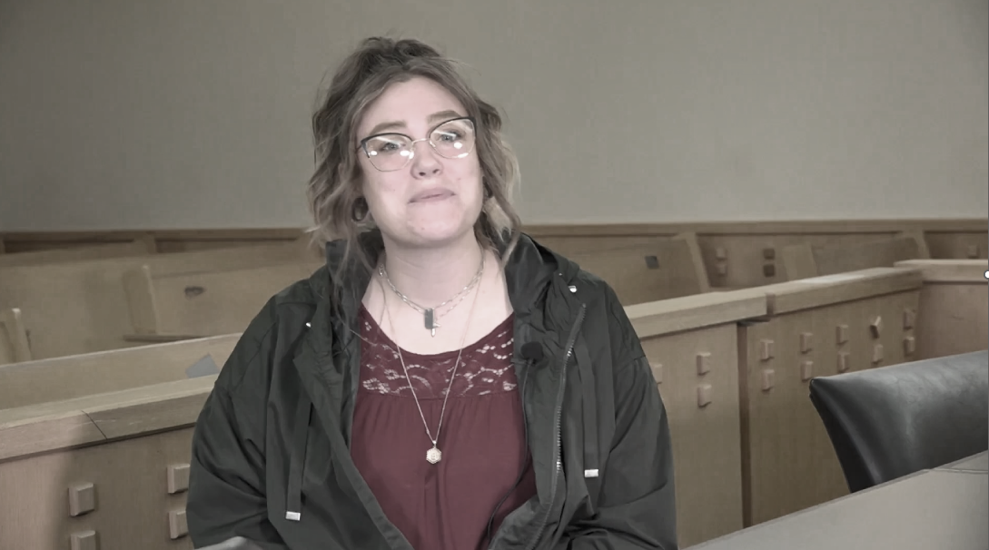
Getting a Different Outcome

Slide 13
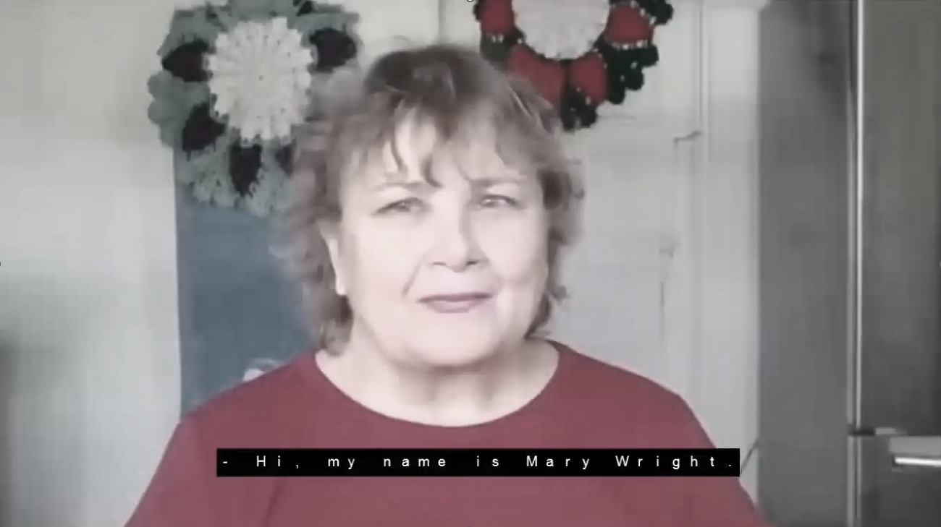

Slide 14
Mental Health Court Analysis
Typically use Drug Court Model
Data
Anecdotes
Early intervention AND Mental Health Courts
Space for both
Flexible
Court or docket
Focus on: Veterans, First Responders, Trafficked Persons, Adults, Children, co-occurring IDD
Notes:
1.Dr Marlowe
2.Both/AND
acknowledge that mental health courts have their critics. Some advocates are concerned that mental health courts might bring more people into the justice system. They would urge us as a society to invest in prevention rather than after individuals have already entered into the justice system. We agree that the development of a mental health court should take place in the context of broader efforts to improve the response to people with mental illnesses involved with the justice system. We encourage every community to look at the system as a whole and balance their efforts across the many intercepts where we might be able to divert someone away from the system. For judges, though, there is a great demand to improve their response to the individuals already in the justice system. And Texas judges have seen lives being changed through mental health courts.
3.flexible

Slide 15
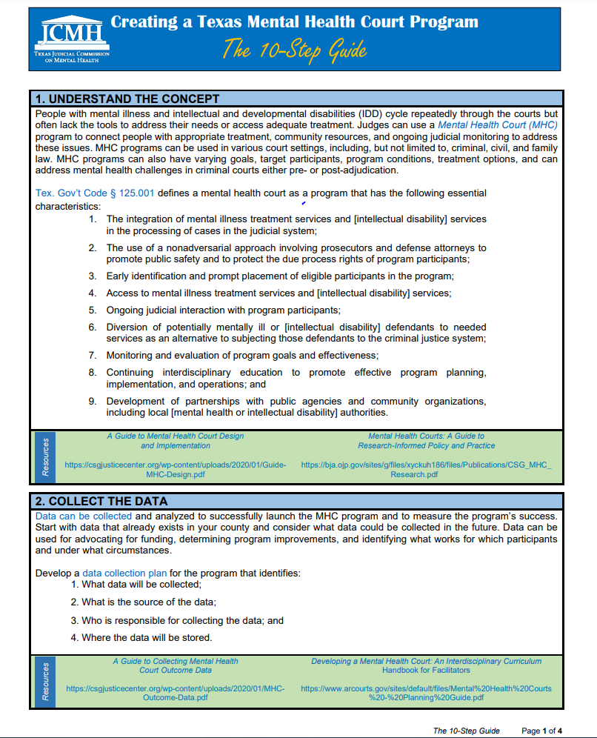
Mental Health Court 10-Step Guide

Slide 16
MHC Step 1: Understand the Concept
Break cycle by connecting people to appropriate treatment, resources & ongoing judicial monitoring
Pre- or Post-adjudication
Does your state define Mental Health Court?
*In Texas, Tex. Gov’t. Code § 125.001

Slide 17
MHC Step 2: Collect the Data
What data already exists?
What data is needed?
Develop a data plan:
What data will we collect?
Where will the data come from?
Who will collect it?
Where will we store the data and how do we keep it safe?

Slide 18
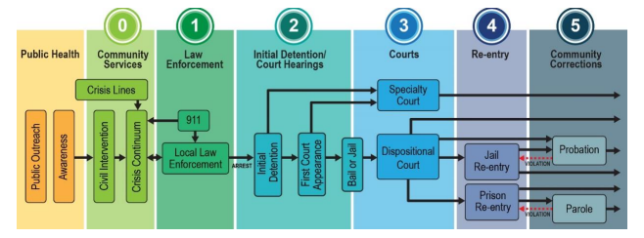
MHC Step 3: Map Community Resources
Consider a Sequential Intercept Model Mapping
Convenes stakeholders
Identifies available resources, service gaps, and opportunities for diversion
Prevents duplication of efforts

Slide 19
MHC Step 4: Select the Team
Judge
Defense Attorney
Prosecutor
Supervision officer (pretrial/probation/parole officer), and
Case Manager or representative from the local mental health authority.
Treatment provider

Slide 20
MHC Step 5: Train the Team
Shadow other courts
NPC Research
Council on State Governments
Center for Court Innovation

Slide 21
Mental Illness
An illness, disease, or condition that either: substantially impairs a person’s thoughts, perception of reality, emotional process, or judgment; or grossly impairs behavior as demonstrated by recent disturbed behavior. The term, as statutorily defined, does not include epilepsy, dementia, substance abuse, or intellectual disability. Tex. Health & Safety Code § 571.003
Note: Chapter 46B of the Code of Criminal Procedure also defines this term and, in contrast to the definition above, provides that mental illness is an illness, disease, or condition that grossly impairs (rather than substantially impairs) a person’s thoughts, perception of reality, emotional process, or judgment; or grossly impairs behavior as demonstrated by recent disturbed behavior. Tex. Code Crim. Proc. art. 46B.001(11)

Slide 22
Intellectual Disability
ID means significantly subaverage general intellectual functioning that is concurrent with deficits in adaptive behavior and originates during the developmental period. Tex. Code Crim. Proc. art. 46B.001(8); Tex. Health & Safety Code § 591.003

Slide 23
Developmental Disability
Manifests before age of 22; severe chronic disability that involves impairments of general mental abilities resulting in at least three out of six of the following functional limitations:
Examples of such disabilities include autism-spectrum disorder, fetal alcohol spectrum disorder, and cerebral palsy.

Slide 24
What is Trauma-Informed Care? ​

Slide 25
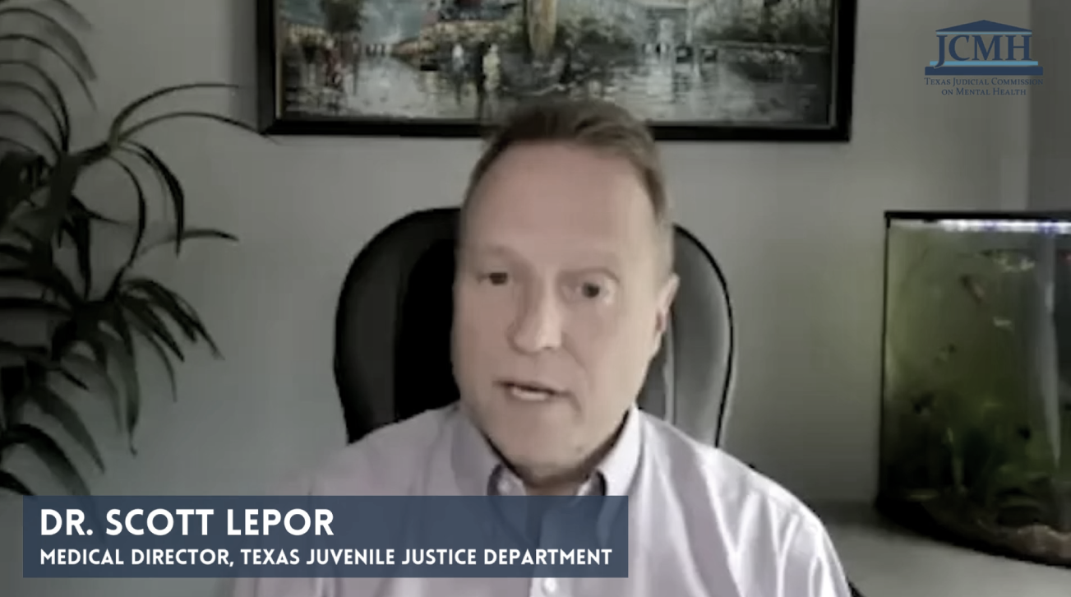

Slide 26
What is SPARKS and How Does it Work? ​

Slide 27
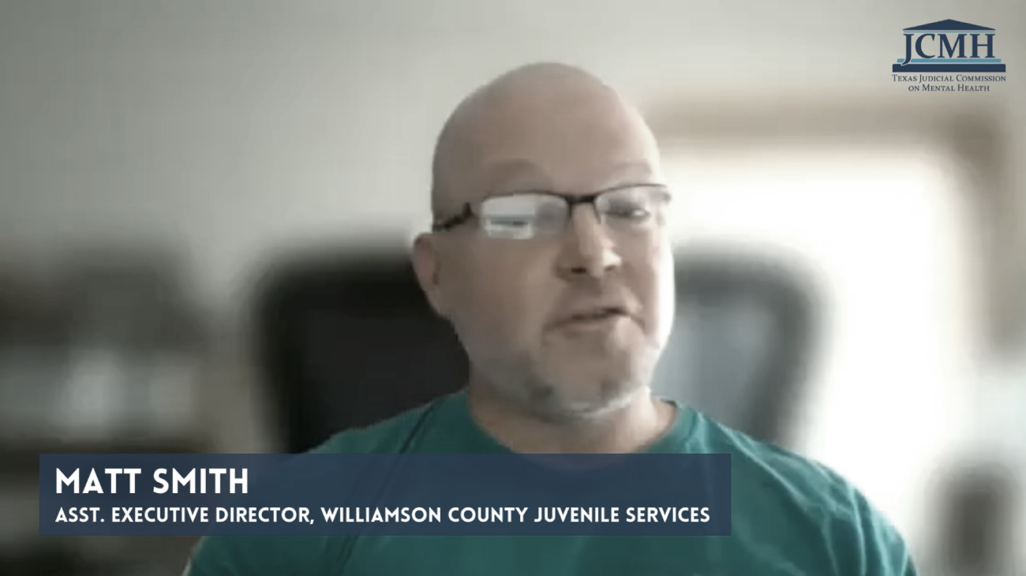

Slide 28
Can you Briefly Explain
Motivational Interviewing?

Slide 29
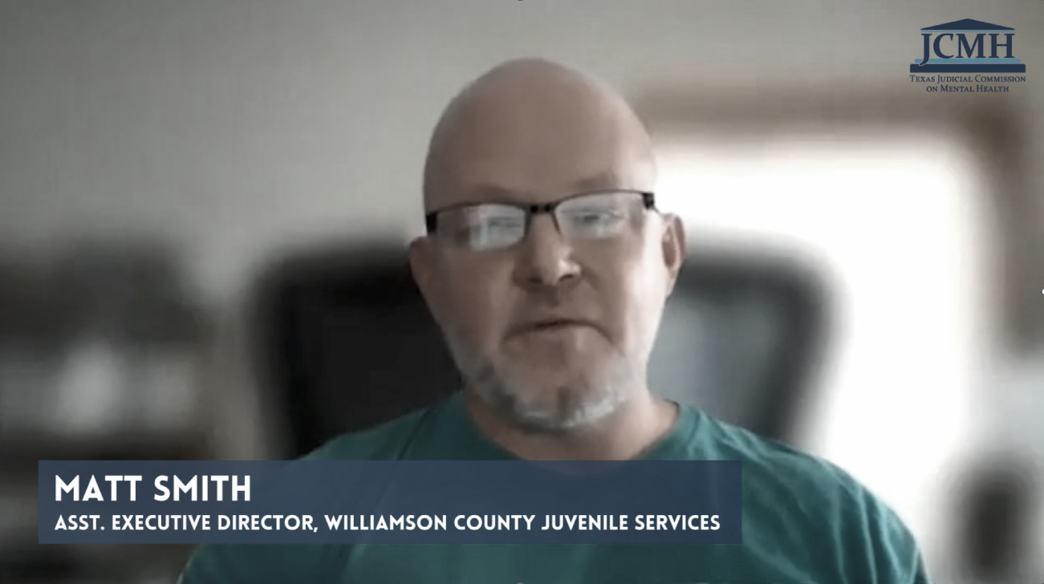

Slide 30
MHC Step 6: Identify Participants
Offense type & level
Screening and Risk Assessment Tools
Mental Health Evaluation
Diagnosis
Referral Process
Final Eligibility

Slide 31
MHC Step 7: Plan the Program
Unsuccessful Program Completion
Individualized Treatment Plans
Incentives and Sanctions
Successful Program Completion

Slide 32
MHC Step 8: Document the Work
Policy and Procedures Manual
Participant Handbook
Referral and Screening Procedures (HIPAA release)
Eligibility Criteria
MOUs
Incentives and Sanctions
Integrated Case Plan Template
Program Goals and Measurable Objectives
Program History and Partners
Case Staffing and Status Hearing Procedures

Slide 33
MHC Step 9: Find Funding
Many start with little or no funding
Start small and use existing resources
Gather data to present to Commissioner’s Court or community organizations
Don’t be intimidated by state or national grants

Slide 34
MHC Step 10: Register the Court*
MHC Programs should be registered with the Office of Court Administration
Programs must meet requirements of Tex. Gov’t. Code § 125.001 to register
* If required in your state

Slide 35
Think About the Children

Slide 36
Juvenile Mental Health Courts
Pre- and Post-Adjudication Models
Denton SOAR Court: higher risk, higher needs
Bexar Crossroads & MIND Courts: Younger girls & boys
Caregiver involvement is key
Sealing*
*In Texas, juvenile cases are automatically sealed at age 19 if there is no adjudication or only a misdemeanor adjudication and no adult conduct; some felony adjudications and all misdemeanor adjudications can be sealed by application at age 17 or if one year has passed since final discharge.

Slide 37
Tarrant County Project SAFeR
Includes Diversion program for younger kids with SBPs referred to the Juvenile Court
Typically with 1 or more MH concern (ADHD, anxiety, depression)
Includes Clinical Intervention for adolescents with SBPs in and out of the juvenile justice system
Based on research by Dr. Jane Silovsky and a clinical intervention program in Omaha, NE for children with SBPs
Treatment is Trauma-Informed CBT

Slide 38
Tarrant County Project SAFeR
Evidence based treatment + legal requirements + parental component produced strong outcomes for the juvenile
Comparison group (similar aged youth without SBPs), play therapy group, and TI-CBT group
TI-CBT was found to result in significantly lower recidivism than play therapy
At ten years out, the TI-CBT group had recidivism rates indistinguishable from comparison group

Slide 39
Tarrant County Project SAFeR
Eligibility:
10-12 years old who have committed a sexual offense
Must be approved by MDT at staffing
Must admit to their offense
Victim's family must consent to the program
No weapons used
Counseling program is 22 weeks
Supervision by Juvenile Sex Offender Unit

Slide 40
Tarrant County Project SAFeR
Juvenile admits guilt in court during hearing
Judge withholds judgment and orders juvenile to complete SAFeR
Case is staffed at halfway point at before graduation
Success = dismissal
Unsuccessful = adjudication, proceed as typical case
Caregiver must participate in counseling and education groups
Case autosealed at 19, or by application if 2 years since final discharge

Slide 41
Tarrant County Project SAFeR
Children's Group:
Sex education
Rules about sexual behavior, privacy, and boundaries
Impulse control and problem solving strategies
Social and peer-relationship skills, and skills to acknowledge and apologize for inappropriate sexual behaviors
Caregiver Group
How to address sex ed topics with children
Making and applying rules for sexual behavior
Supporting abuse prevention strategies
Sexual development, moral development and general child development

Slide 42
Tarrant County Project SAFeR
Kevin's case
Abused by older cousin
Acted out with younger siblings
Isolated from family
Approved for Project SAFeR
Everyone got the services and skills they needed
Dramatic turnaround
Successful graduation
Intact, stable family
After 8 years, 93% successful completion + no recidivism

Slide 43
Resources

Slide 44
JCMH Technical Assistance
Bench Books
MH Law
Training & TA
MH Court Support
Peer Networking
Legislative Initiatives
Video Library
Notes:
Examples of JCMH Technical assistance

Slide 46
Contact us Hon. Brent Carr: judgebcarr@gmail.com Kristi Taylor: Kristi.taylor@txcourts.gov Molly Davis: molly.davis@txcourts.gov www.texasjcmh.gov

