Slide 1
NGRI Basics: how hard could it be?
6 24 26
Krista Chacona

Slide 2
The Numbers: NAMI & SAMHSA estimate…
Nationwide (2024):
Compared to:
23.4% of U.S. adults experienced mental illness - ≤1 in 5 adults; 16.5% (1 in 7) kids 6-17
5.6% of U.S. adults experienced severe mental illness - 1 in 20 adults.
3.8% of U.S. adults experienced a co-occurring substance use disorder
50% of all lifetime mental illness begins by age 14, and 75% by 24
About 2 in 5 incarcerated have a hx of mental illness (37% in state and federal prisons and 44% in local jails).
  66% of women in prison reported having a MH hx, almost twice that of men in prison.
And up to 72% of those have a dual diagnosis;
More than 65% of youth in the juvenile justice system suffer from MI

Slide 3
A Houston study also estimated up to 40% of individuals in the criminal justice system (incarcerated or on probation/parole) suffer from mental illness; other studies estimate that number at closer to 50%
The Numbers
Nearly 1 in 4 people shot and killed by police officers between 2015 and 2020
had a mental health condition. Some studies say is closer to 2 in 4
Why start here?
**If you are part of the CJS, you are likely to encounter people living with mental illness

Slide 4
MH basics
Before you even meet client can look for signs may have MH hx - where client is housed in the jail (medical?), does PC affidavit mention odd behavior or drugs found? Was a 16.22 ordered?
Not every difficult client is MI
Not every MI client is incompetent, fewer are insane
Not every client needs a competency and/or a sanity evaluation
If competent, MI clients are permitted to make same decisions regarding their case, good or bad, as any other client

Slide 5
Incompetency: the law 46B
• Art. 46B.003(a) “A person is incompetent to stand trial if the person does not have:
(1) sufficient present ability to consult with the person’s lawyer with a reasonable degree of rational understanding; or
(2) a rational as well as factual understanding of the proceeding against the person.”
BUT ALSO:
• Art. 46B.024 [A]n expert shall consider…
(1) the capacity of the defendant during criminal proceedings to:
rationally understand the charges against the defendant and
the potential consequences of the pending criminal proceedings;
(B) disclose to counsel pertinent facts, events, and states of
mind;
(C) engage in a reasoned choice of legal strategies and options;
(D) understand the adversarial nature of criminal proceedings;
(E) exhibit appropriate courtroom behavior; and
(F) testify

Slide 6
Sanity – §46C CCP
To be insane, §8.01 of the Texas Penal Code requires that:
“… at the time of the conduct charged, the actor, as a result of severe mental disease or defect, did not know that his conduct was wrong.”

Slide 7
Breaking it down…
Affirmative defense - Defendant must show by a preponderance of the evidence that he/she was insane when act committed. [CCP Art. 46C.153]
**AT THE TIME OF THE CONDUCT CHARGED
As a result of SEVERE mental disease or defect
  **Does not include an abnormality manifested only by repeated criminal or antisocial conduct. NOT just substance abuse)
The actor, did not now that his conduct was wrong i.e. illegal
**Often difficult to prove defendant did not know conduct was considered wrong because often, knew illegal.
Your client must be found competent before an Expert can determine sanity at the time of the offense.

Slide 8
Compare to competency…
Competency
Insanity
Presumed competent to stand trial; must be proven incompetent by preponderance of the evidence
Is not a defense
Competency is an ongoing issue.
Due process issue. Attorney required to evaluate if GFB client may be IST, can’t proceed.
If IST, ordered to tx to RESTORE competency and resume prosecution
Time out at max possible sentence, can refer for civil commitment
Presumed sane
Insanity is an affirmative defense. State must prove case BRD. Then defense must prove insanity by a preponderance of evidence.
Is static – was client insane at time of offense?
If competent, client can decline to pursue insanity or other MH claim
If found insane, prosecution ends, ordered to tx until no longer danger to self or others
Time out at max possible sentence, can refer for civil commitment
**VERY different concepts, processes
& implications

Slide 9

Attorney-client relationship – the balance of power
Typical representation balance of power is clear (6th Amendment):
  Client fundamental decisions (testifying, accepting a plea, waiving jury, appeal) and
  Lawyer makes strategic decisions (arguments, witnesses to call, objections to raise, etc.)
Except when talking about incompetency
Due process demands that a defendant cannot be prosecuted if they are incompetent to stand trial. Is lawyer’s DUTY not to allow.

Slide 10
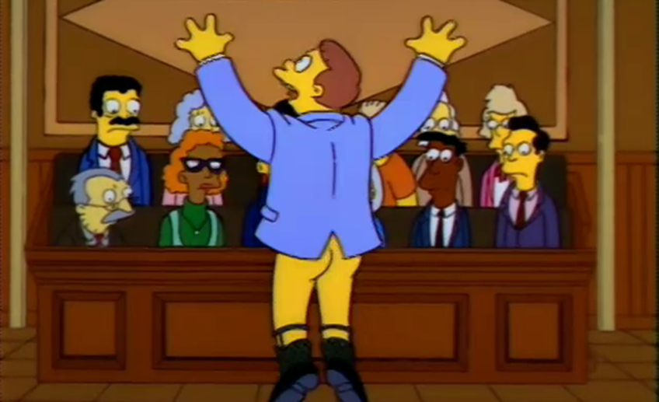
So what if Client doesn’t want to be found incompetent and asks to represent himself?
The 6th Amendment also guarantees the Defendant’s right to self-representation - change when Client is mentally ill? Under what circumstances can the Court deny Defendant’s right to proceed pro-se?
Two scenarios:
1) If the Court believes
Defendant may be IST, Court must
appoint counsel to represent
Defendant in competency
proceedings (until restored)
2) If MI Defendant is
competent to stand trial only with the
assistance of counsel and would not be competent to proceed without counsel, Court can say Defendant is not competent to proceed pro se, but prosecution will resume.

Slide 11
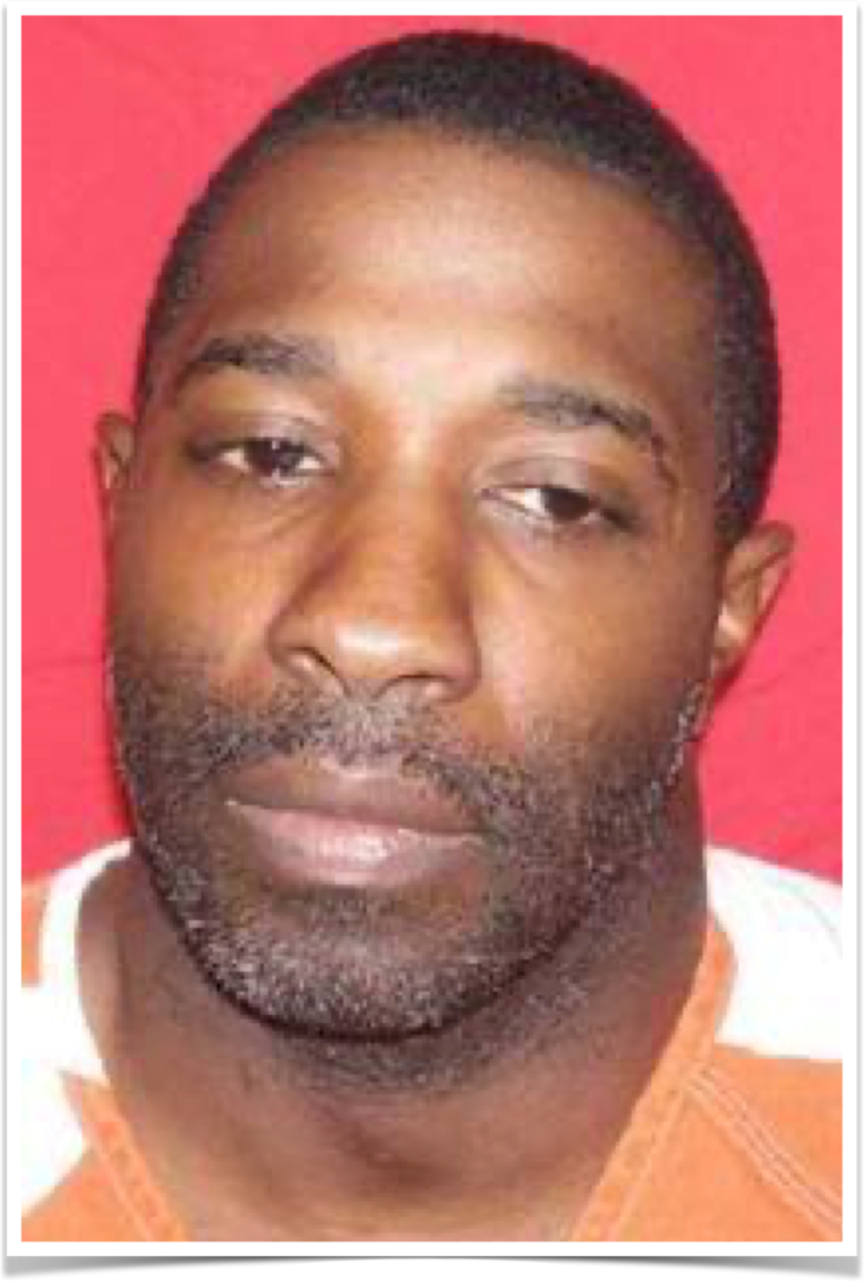
How relate to insanity?
If Client is competent to proceed, they are entitled to make all of the fundamental decisions any other Client would make – good or bad. Including whether to present evidence of insanity.
Remember: Insanity is an affirmative defense – requires admit conduct but say not responsible due to MI.
In McCoy, the Court held the 6th Amendment guarantees a defendant the right to decide that the objective of his defense is to maintain innocence at all costs, even when counsel believes that admitting guilt offers the defendant the best chance to avoid the death penalty.
McCoy v. Louisiana 584 U.S. ___ (more)
138 S. Ct. 1500; 200 L. Ed. 2d 821
,

Slide 12
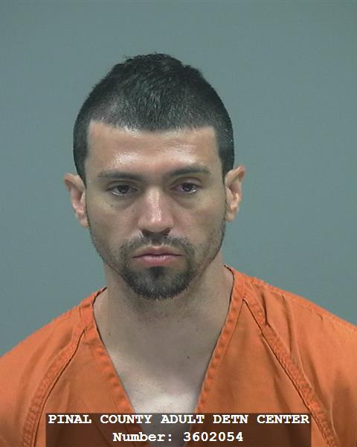
So what does else McCoy mean to us?
“We address a question of first impression: whether a criminal defendant has the Sixth Amendment right to demand that counsel not present an insanity defense.
We hold that McCoy v. Louisiana, 138 S. Ct. 1500 (2018), requires under the facts of this case that the demand be honored. We therefore reverse and remand for a new trial.”
HAWKINS, Senior Circuit Judge
The panel held that in light of McCoy v. Louisiana, 138 S. Ct. 1500 (2018), a district court commits reversible error by permitting defense counsel to present a defense of insanity over a competent defendant’s clear rejection of that defense. And…
The panel held that the district court did not err by revoking his pro se status under Indiana v. Edwards, 554 U.S. 164 (2008), on the basis of his “decidedly bizarre” and “nonsensical” arguments.
USA v READ -9th Circuit 17-10439
It is Scenario 2 – Defendant competent with assistance of counsel. And since competent, can elect NOT to pursue insanity defense.

Slide 13
Mitigation
Case also includes decision about the presentation of mitigation evidence. Even if you cannot use client’s mental illness at guilt/innocence, as the basis for an affirmative defense or rebut or negate an element of the crime, it can be very useful in punishment. More importantly, counsel’s failure to do so can result in an ineffective assistance of counsel finding.
Counsel’s obligation to present mitigation evidence has been an important issue for the courts, especially in DP cases. Supreme Court held a capital defendant has the right to present mitigating evidence and defense counsel can be ineffective for failure to investigate mitigation, but Defendant can elect to forgo presentation of mitigation evidence, including evidence of MI.
  In Texas, we have Ex parte Michael Dee Howard, unpublished opinion No. AP-76,809 (9/11/13)
2nd, published opinion (4/2/14). On habeas court’s finding that Howard was prejudiced at trial by trial counsel’s failure to use insanity caused by intoxication as mitigation evidence during punishment, Court found trial counsel ineffective and remanded case back for a new punishment hearing even though Howard did not raise this issue.
Could not find where defense counsel has ever actually presented mitigation evidence over the Client’s objection, so the Court has not ruled on whether the decision to present mitigation evidence is Client’s or Lawyer’s, but assume be same as insanity. But most importantly…
Where a competent defendant elects to forgo mitigation evidence he cannot later assert IAC for failure to present mitigation evidence.

Slide 14

Where start?

Slide 15
Motions & Experts: tips
Meet with client ASAP to assess.
  If suspect may have insanity case, get expert ASAP. Even if can’t assess for insanity yet, lay eyes on client and see how client presents close in time to offense.
DO NOT show client the discovery until all experts (including State’s) have spoken with them
Choose right expert for job – sometimes know early, sometimes need more than one.
  Generally start with preliminary decision – psychiatrist or psychologist?
File an Ake motion ex parte to get experts for competency & sanity. ALWAYS.
  Do not file as 1 motion. File for competency first (even if think CST), then sanity after expert sees client
  Opinions may be disclosed to the Court and the prosecutor later, if you make these issues in the case, but you need to see them first.
    Prepare the client (to the extent you can) and remind the doctor is ex parte.
    Make sure all reports disclosed & filed are sealed by court
Start gathering information – records from school, past treatment providers (hospitals, jails,
LMHA), hx from family. Videos from arrest and anything else that sheds light of state of mind
before/during/immediately after offense – get creative and think outside box.
**Use an investigator and mitigation expert to help gather documents

Slide 16
Pleading your defense
In order to use NGRI as a defense, you must plead it in a timely manner. Even if client pleads “not guilty” at magistration and/or arraignment, you can later invoke the defense by filing notice
Before filing notice, discuss options and make sure client understands consequences of different verdicts, especially NGRI
  Client may be undecided when file, but must be on board before plea or trial
If an Expert determines your client was insane, and you want the option to pursue insanity defense must, you must give notice to the State. State has right to have client evaluated by their own expert. **This is triggered by your notice
**Notice must be given at least 20 days before trial or at the pretrial hearing.

Slide 17


State and Defense can agree client was NGRI – best solution for safety
Trial (Judge or Jury)
Hearing on the record- finding that the State could prove the elements BRD, the defense could prove the affirmative defense of insanity.
State must prove their case BRD, present evidence of defense of sanity

Slide 18
Trial considerations
Jury does not get to hear what happens if NGRI. [CCRP Art. 46C.154] What can you do?
Verdict options – guilty, not guilty, or NGRI (make sure you & client know ramifications)
Should your client testify?

Slide 19
Client participation in decisions
Can be a challenge to get the Client to trust you enough to confide the truth, participate in the process and trust your advice.
Particularly challenging with a MH client
  May be suffering from paranoia
  May have difficulty focusing or
  Often ignored or discounted – treated as stupid or incapable of making decisions, sometimes by the very people who are there to help
**Important not to treat them as broken or wrong.
**Need their trust to get their buy-in for best defense strategy

